Slide 1
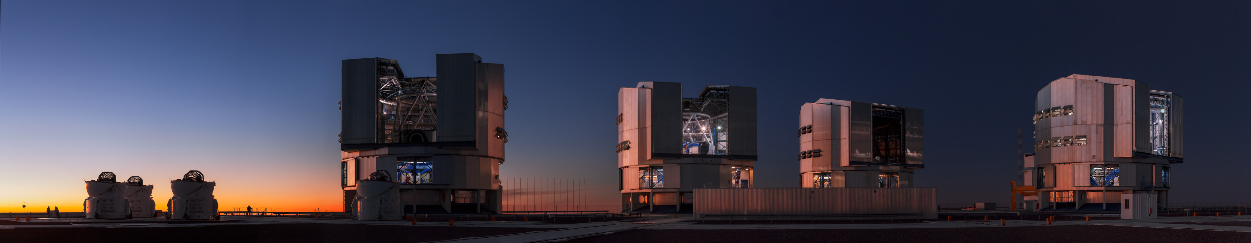
My background
Credit: ESO/B. Tafreshi (twanight.org)
Experimental condensed matter physics background
Low-energy positron diffraction
Low-temperature, ultra-high-vacuum scanning tunneling microscopy
Professional experience in observational science environment
European Southern Observatory’s Paranal Observatory
Instrumentation & systems engineer specialized in adaptive optics
Scientific software developer
Primarily focused on applications
Always working on scientific instrumentation
Notes:
Emphasize that implicit in this is my belief that developing scientific software is developing a scientific instrument – not just analogous
This slide should give them context for understanding my point of view.
Physics was mostly about designing, constructing, all aspects of scientific data including data analysis.
* Observatory was working to ensure high-quality results with full context so that public can do science
While my experimental background was closer to R&D, the observatory work was clearly more about operations - Paranal is a science factory. This is different in some ways, very rigorous, and at a very large scale. To adapt ideas/tips/tricks/tools for observatory, there needs to be some simplification.
Part of working on scientific instrumentation is understanding how the data is generated and therefore understanding how to correctly and rigorously analyze data and draw conclusions from data.

Slide 2
Meta conclusions
This module
Was not about sharing knowledge, but
Was about (hopefully) building understanding.
We established concepts, pros/cons, difficulties, & questions.
The next talk will address these in concrete way.

Slide 3
From my perspective
Software best practices are foundational science & are mandatory
Knowledge management can improve science & productivity
Productivity can arise from selflessness
Not all documents are alike
Not all lab notebooks are alike
Lab notebooks are mandatory
Lab notebooks allow for learning
Lab notebooks for CMSE are hard
To be continued…

